Slide 1


Telehealth’s Evolution in California: Where Are We, and Where Do We Go from Here?

Slide 2
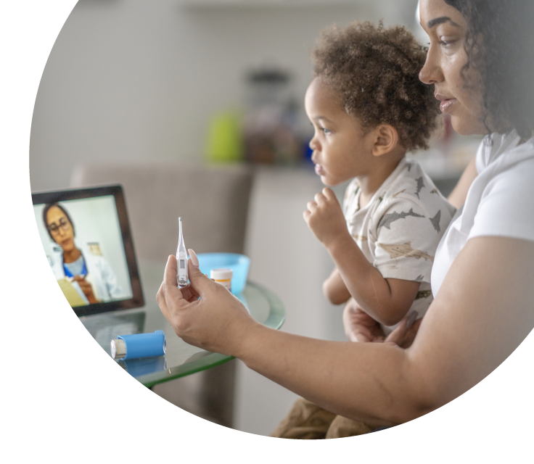
Telehealth’s Evolution in California: Where Are We, and Where Do We Go From Here? Webinar February 6, 2025

Slide 3


Presenters
Natasha Arora, MS, evaluation and learning associate, Center for Community Health and Evaluation
Diana Camacho, MPH, senior program officer, California Health Care Foundation

Slide 4





Panel discussion
Mei Kwong
Center for Connected
Health Policy
Moderator
Dr. Barbara Rubino
Covered California
Dr. Elaine Khoong
UCSF
Erica Holmes
DHCS
Mark Schweyer
Health Net of California/
Centene Corporation

Slide 5

Telehealth’s Evolution in California: Progress, Challenges, and Opportunities
Diana Camacho, California Health Care Foundation
Natasha Arora, Center for Community Health & Evaluation

Slide 6





Today we will
Explore telehealth progress and lessons learned from health care leaders
Gain a deeper understanding of existing challenges and future opportunities
Examine steps to reach telehealth’s potential to support health equity
Notes:
Talking points
Diana intro
Why has the foundation been supporting telehealth as a tool to advance equitable access to health care?
Reasons for summative evaluation: Celebration of what we’ve learned and a road map for the future
Thank you to CCHE, cosponsors, and advisers
Info on where to access the report / link / QR code
SCAN ME

Slide 7
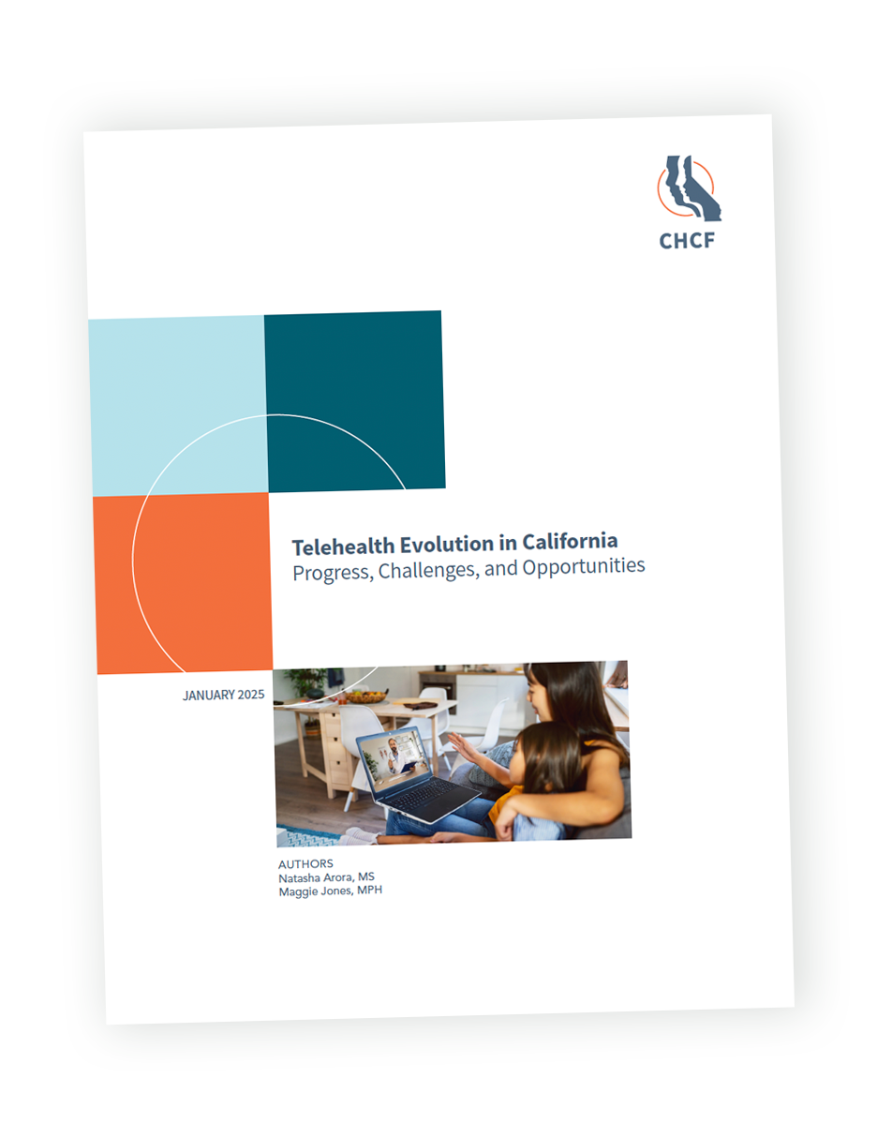

Scan to
download
Notes:
Talking points
Diana intro
Why has the foundation been supporting telehealth as a tool to advance equitable access to health care?
Reasons for summative evaluation: Celebration of what we’ve learned and a road map for the future
Thank you to CCHE, cosponsors, and advisers
Info on where to access the report / link / QR code
SCAN ME

Slide 8
We need that appointment, but
we hesitate because we can’t ask for time off. . . . [With telehealth], we can work around our lunch or break schedule . . . and they’re more likely to say yes than [to] requesting a whole day.
I don’t have a vehicle, so
telehealth allows me to utilize
[specialist] care that I just would not have
access to otherwise. . . . Given the nature of my disabilities, I don’t always remember my
appointments or have a general ability to
get myself mobile enough to get to them. So
having providers who are aware of that, who
can then contact me and still maintain the
Appointments, is incredibly helpful.
A 44-year-old Latina/x
in Los Angeles
A 30-year-old nonbinary person in Northern California
Jen Joynt, Telehealth Experiences and Preferences Among Californians with Low Incomes, CHCF, May 2023.
Notes:
Talking points:
Why telehealth?
A tool for advancing access to care and for equitable access to care
Telehealth reduces barriers to accessing care: transportation, time/time away from work, barriers related to disability (mobility, challenges being in new places, etc.).

Slide 9
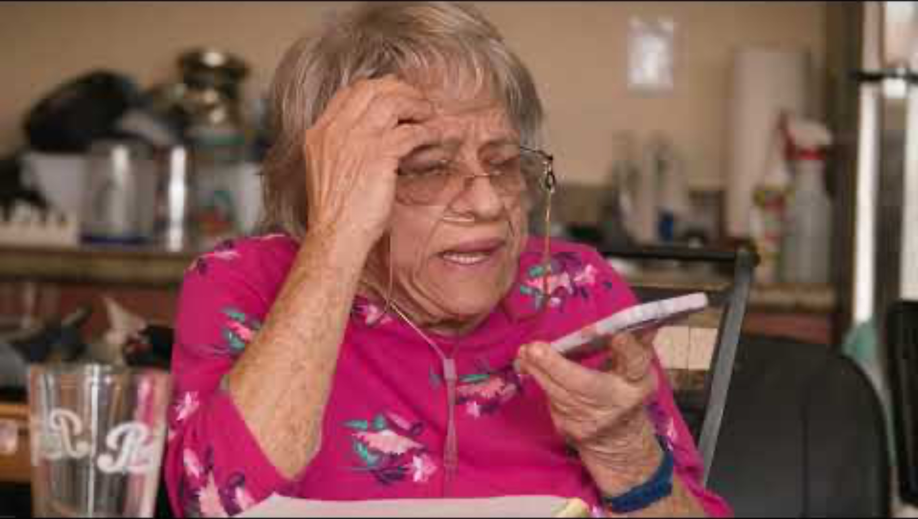
Notes:
Talking points:

Slide 10
The authors found progress across
Policy and Financing
Use and Consumer Interest
Telehealth
Implementation
Research
Notes:
Talking points
California has made progress toward advancing access to telehealth across many areas, including:
Policy & financing. Evolution in the telehealth policy environment has made telehealth available, including to patients using Medi-Cal.
Consumer/patient interest and perception of telehealth. As a result of telehealth’s widespread availability, patients are interested in using telehealth and would like it to be a regular part of their care.
Research. The body evidence on telehealth continues to grow, particularly following the surge in telehealth use during and after the COVID-19 pandemic.
Telehealth implementation. Telehealth is widely available to patients, including in California’s clinical safety net.
Because telehealth has evolved so much in the past several years and is clearly here to stay, it seemed a good time to celebrate progress and to take a critical look at the challenges — particularly the equity challenges related to telehealth access — and to think strategically about what next steps will continue to support access to telehealth.
As part of this effort, we reviewed dozens of documents/literature and conducted interviews with key informants. We interviewed 27 people — including many in this room — working in the areas of telehealth policy, implementation, and research. We appreciate all of you who provided your insights. This effort reflects the expertise of those who have been working in the telehealth space; our role was to listen and synthesize.

Slide 11
:Policy + Financing
FINDINGS
Policy change has driven telehealth adoption
Setting the stage
Before 2020
Starting in 2020
1996: Medi-Cal coverage for telehealth begins
Most telehealth took place in designated locations (such as a patient in a primary care clinic meeting virtually with a specialist)
Public health emergency waivers
Telehealth allowed from home or other locations
Allowed telehealth outside of rural and Health Professional Shortage Areas
Medi-Cal became a national leader in reimbursement
Ongoing Medi-Cal payment for telehealth
Other supportive policies such as broadband access, community health workers, school-based services
Payment parity for audio-only, video, and in-person visits
eConsult programs were robust, particularly within county health systems
Notes:
Policy & Financing
Talking points
California made many telehealth-related policy advances before 2020, which set the stage for progress during and after the pandemic.
Coverage of telehealth by Medi-Cal began in 1996, making Medi-Cal a leader in reimbursement for telehealth in California.
Was more lenient than Medicare — for example, it allowed telehealth outside of rural and Health Professional Shortage Areas.
Before 2020, most telehealth was from clinic-to-clinic; for example, for specialty care access.
E-consult programs were also robust before 2020 — particularly with in-county health systems.
Policy changes from 2020 onward allowed for expanded use of telehealth. Initially, these were a result of waivers under the public health emergency, but have evolved into permanent policy.
Telehealth allowed from home and other locations
Ongoing Medi-Cal payment for telehealth
Payment parity
Other supportive policies: broadband access, community health workers, school-based services
Changes in policy have been facilitated by California Telehealth Policy Coalition, increased consumer demand, DHCS interpretation.

Slide 12
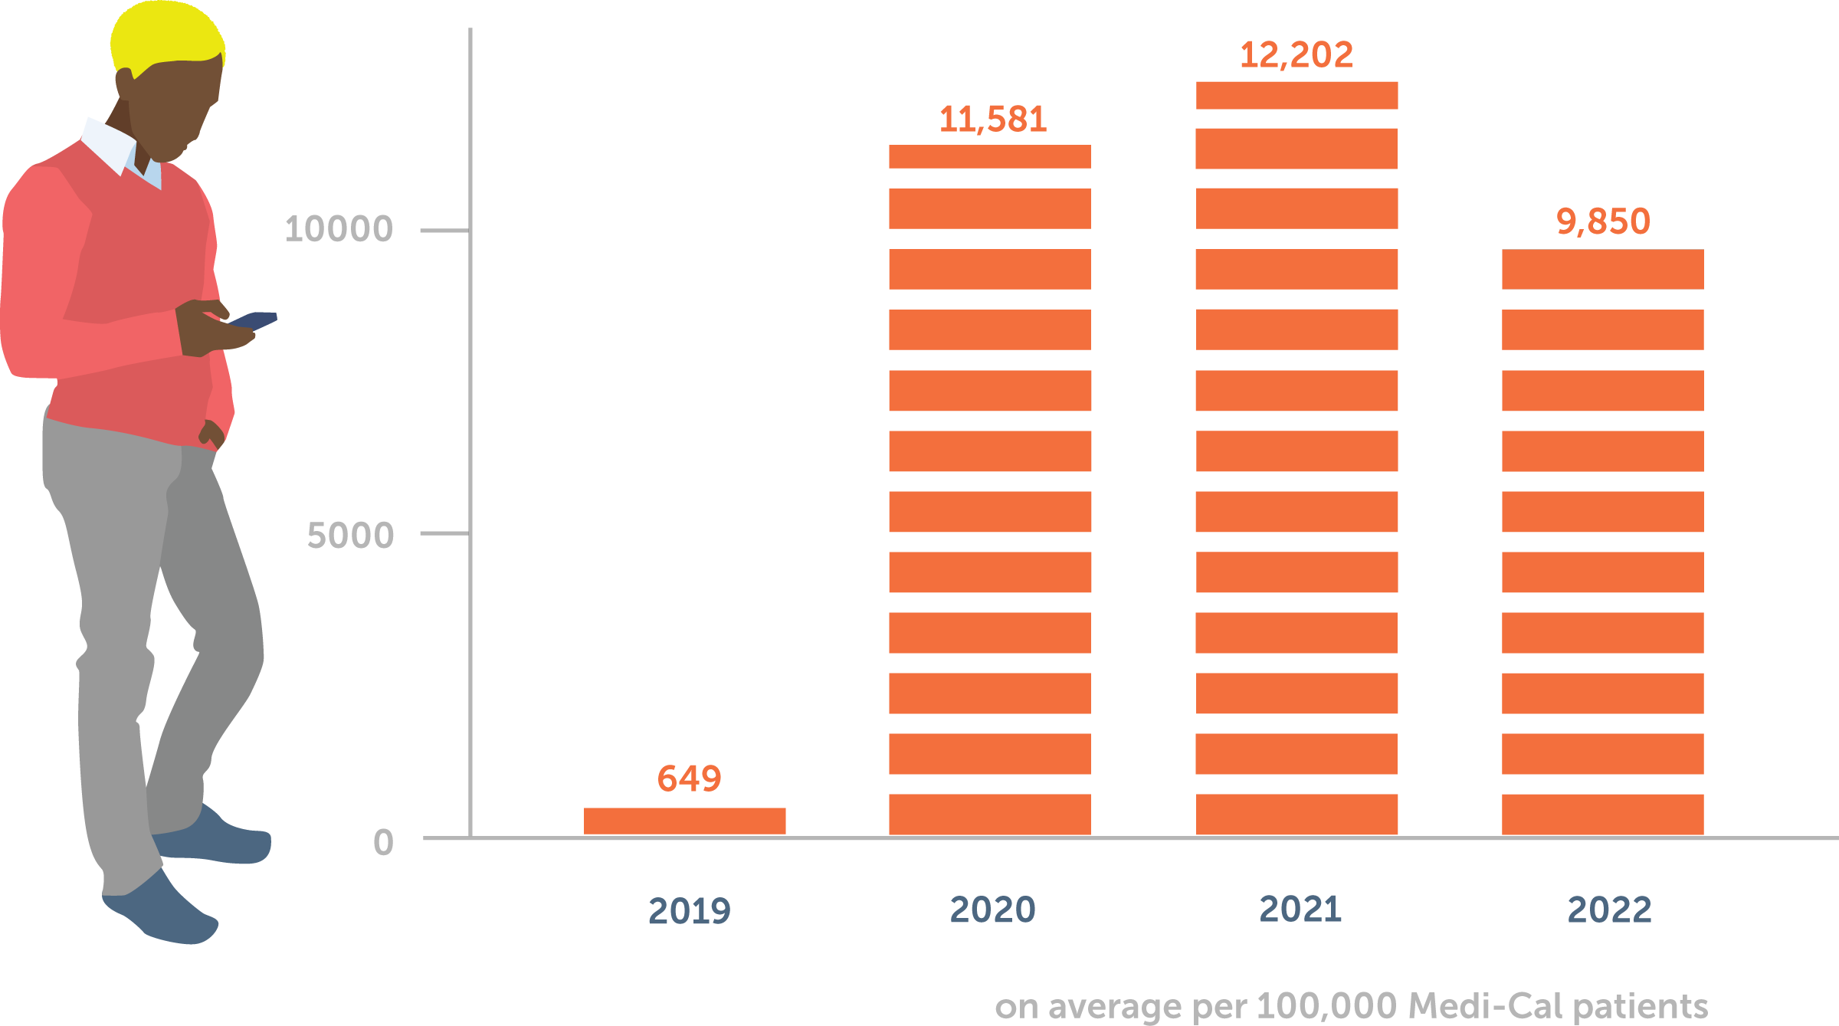
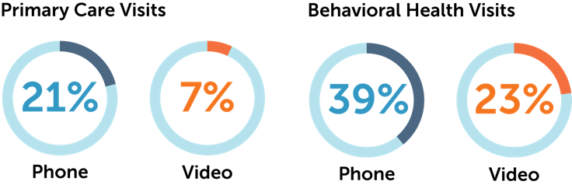
Use and Consumer Interest
FINDINGS
Telehealth use has grown in recent years and remains popular
Notes:
Utilization & Perception
Talking points
Telehealth use has grown in recent years and remains popular.
…………………….
///// DESIGN NOTE
I pulled sample findings and recommendations for this and the next two slides. If this works, you’ll want to say that this is one finding among many others detailed in the full report.

Slide 13
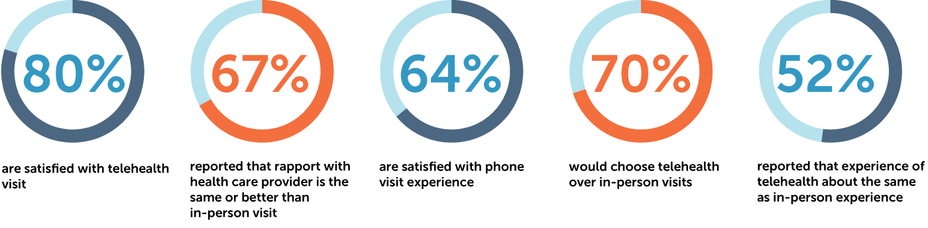
Use and Consumer Interest
FINDINGS
Patients who use telehealth wish to continue
Notes:
Talking points
Why telehealth?
Patients are satisfied with telehealth and would like to continue using it. The data above come from several sources — research commissioned by the California Health Care Foundation on patients’ experiences with the health care system, results from the California Health Interview Survey, and national survey data collected by Harvard and the Robert Wood Johnson Foundation. Across all sources we see that patients are satisfied with their telehealth visits and experience rapport with their providers during telehealth visits. About half of patients found that their telehealth experience paralleled their experience with in-person care.
Sources:
Michael A. Kyle, Robert J. Blendon, Mary G. Findling, and John M. Benson, “Telehealth Use and Satisfaction Among U.S. Households: Results of a National Survey,” Journal of Patient Experience 8 (October 29, 2021): 23743735211052736, https://doi.org/10.1177/23743735211052737.
Jen Joynt., Lucy Rabinowitz, and Rebecca Catterson, Listening to Californians with Low Incomes: How They Experience the Health Care System and What It Means for the Future, California Health Care Foundation, May 2021, https://www.chcf.org/publication/listening-californians-low-incomes-experience-health-care-system-means-future/.
Sean Tan, Telehealth and the Future of Health Care Access in California, UCLA Center for Health Policy Research, October 2023, https://healthpolicy.ucla.edu/our-work/publications/telehealth-and-future-health-care-access-california.

Slide 14
Research
FINDINGS
Evidence on telehealth continues to grow
Synchronous video telehealth has convincing evidence for its use in behavioral health, chronic condition management, and more
Audio-only telehealth also has convincing evidence for use in behavioral health
eConsults increase access to specialty care and reduce costs
Notes:
Talking points
The body of evidence on telehealth continues to grow, particularly following the surge in telehealth use during and after the COVID-19 pandemic.
What do we know about telehealth’s effectiveness? (Probably can’t talk about everything below — will select 2–3 points.)
Synchronous video telehealth has convincing evidence for its use in behavioral health and chronic condition management and promising evidence for other applications.
The delivery system in which telehealth is provided may impact its effectiveness.
Evidence on the use of specific telehealth modalities is emerging.
eConsults increase access to specialty care and reduce costs.
Initial evidence suggests that telehealth has an impact on provider retention and burnout.
However, the overall impact of telehealth on health system costs is unclear, and only limited evidence focuses on telehealth outcomes in the current hybrid care environment.

Slide 15
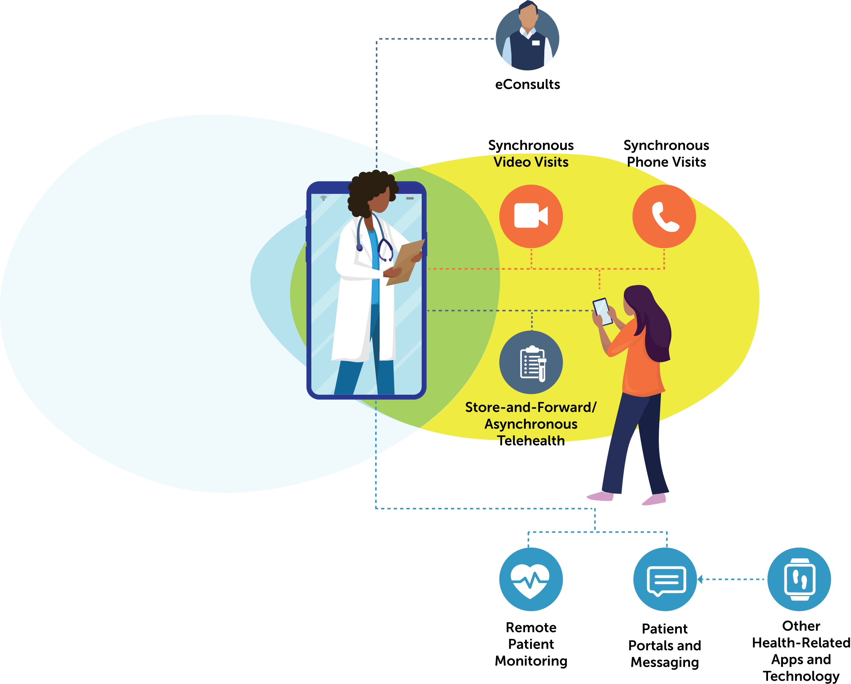
Telehealth Implementation
FINDINGS
Telehealth is widespread in the clinical safety net
Health centers have made the operational and workflow changes needed to deliver telehealth
Screening patients for digital barriers and offering digital navigation support have been key to making telehealth accessible
Notes:
Talking points
Use of telehealth is widespread throughout the safety net, although continued operational changes are needed to make video visits widely available.
Health centers successfully advanced the operational changes needed to deliver synchronous audio-only and video visits to their patients. To do so, practices needed to adopt a video visit platform that met their needs, adapt team-based care workflows to the virtual environment, develop protocols to ensure pre- and post-visit tasks were completed, and ensure that technology support was available for both patients and providers.
And health centers have implemented changes to make telehealth more accessible to their patients:
Screening patients for digital barriers
Digital navigation support
Availability of telehealth within the clinical safety net is particularly important to protect against care fragmentation — so we need to keep forward momentum on telehealth implementation.
Some of the best practices that we have learned about include:
Leadership support for telehealth
Development of operational workflows and systems — using robust engagement from clinicians, frontline staff, and patients
Support for technology adoption and implementation
Screening and supporting patients with digital barriers
Ensuring that digital solutions are culturally and linguistically aligned with patient population

Slide 16
OPPORTUNITIES
Where do we go from here?
Use the momentum gained to:
Ensure sustained reimbursement for telehealth visits
Address policies that limit access to telehealth, particularly for Medi-Cal patients
Address disparities in utilization and access
Protect against care fragmentation by developing robust telehealth programs within the clinical safety net
Expand the evidence base to understand when to use telehealth and how to best implement it
Support promising and innovative practices
Notes:
Where are we now? What challenges remain?
Policy challenges: There are still restrictions on telehealth for Medi-Cal patients:
Modality for establishing care
Consent and referral requirements
E-consult payment in FQHCs
Disparities in utilization and access:
Medi-Cal patients use at lower rates than other payers
Adults above age 65 use telehealth less frequently than younger adults
Patients with limited English proficiency are less likely to access telehealth visits and video visits
People living in rural areas use less telehealth compared to urban or suburban residents
While there is some variation in race and ethnicity, the data are not conclusive
Payer and health system characteristics influence telehealth use
Making telehealth part of the system in which patients already receive care: protecting against care fragmentation
…………………….
///// DESIGN NOTE
These two figures purposefully don’t have devices.

Slide 17




ROAD MAP
Where do we go from here?
POLICYMAKERS
HEALTH CARE
LEADERS + PROVIDERS
HEALTH PLANS
RESEARCHERS
Center Equity
Share and Scale Best Practices
Notes:
Talking points:
The report contains a comprehensive road map for the following audiences: policymakers, health plans, health systems and providers, and researchers, which were generated from the key informant interviews and our document review.
We grouped our recommendations under two key overarching actions:
The first is to center equity. Efforts can be focused on meeting the needs of patients who face significant barriers to accessing health care.
The second is to do what works. We know a lot about what works already and can spread those lessons, yet there is more to learn about what works and is worth investing in.

Slide 18
ROAD MAP
Policymakers
Center Equity
Continue Medi-Cal payment for telehealth
Ensure equal access between Medi-Cal and private insurance
Address licensure
Expand broadband
Share and Scale Best Practices
Support payment models that incentivize safety-net providers to make telehealth services accessible to their patients
Streamline telehealth billing
Address regulatory challenges
Support telehealth monitoring and evaluation efforts

Slide 19
ROAD MAP
Health care leaders and providers
Center Equity
Inform patients of their care options
Screen for digital barriers
Offer digital navigation support
Listen to patient input
Share and Scale Best Practices
Ensure telehealth is part of a hybrid care model throughout California’s safety net
Identify what works for patients, particularly if they are underserved

Slide 20
ROAD MAP
Health plans
Center Equity
Create strategies that offer both telehealth and in-person care options
Communicate options to patients
Share and Scale Best Practices
Incentivize promising uses of telehealth that result in increased access to care or efficiencies in health care delivery
Make billing easy and consistent

Slide 21
ROAD MAP
Researchers
Center Equity
Focus research on the needs, experiences, and outcomes of underserved populations
Share and Scale Best Practices
Generate evidence that helps health systems decide when to use telehealth and how to improve quality of care and access to care for patients using telehealth
Investigate how telehealth is working on the ground

Slide 22
Scan for
more information
Notes:
Links to road map materials or QR code
Transition to panel: Now we will hear from XX YY ZZ about their thoughts on next steps for telehealth.

Slide 23
Panel discussion
Mei Kwong
Center for Connected
Health Policy
Moderator
Dr. Barbara Rubino
Covered California
Dr. Elaine Khoong
UCSF
Erica Holmes
DHCS
Mark Schweyer
Health Net of California/
Centene Corporation

